Slide 1
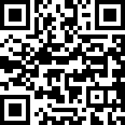
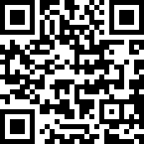
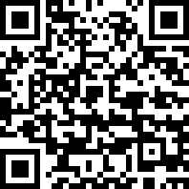
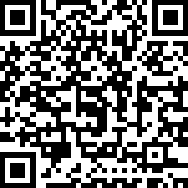
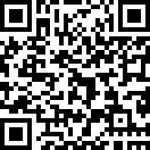
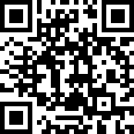
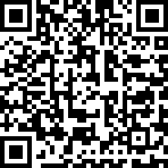
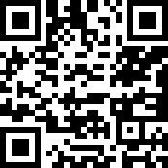
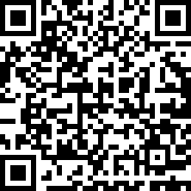
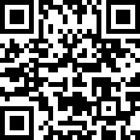
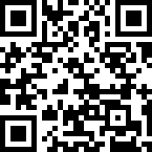
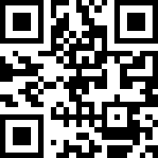
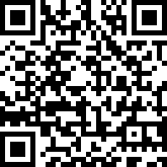
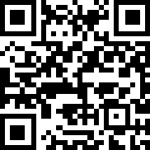
Navigating the Mental HealthCare System: Houston For Adults living with serious mental illness
WHEN TO SEEK CARE
Feelings and situations you may experience
NAMI GH Programs
NAMI GH Support Groups
MHA Houston Screener
In treatment, maintaining levels of independence or seeking self-care help or community support
In treatment, participating in mental health care or transitioning to care after hospitalization
Breakthrough or emerging signs and symptoms
WHERE TO GO
Levels of care
Fort Bend Resources
Houston Behavioral Healthcare
Discovery Program
Thoughts or actions—harm to self or others, medical emergency, severe withdrawal
STABILIZATION AND SUPPORTIVE CARE
TRANSITION SERVICES
IOP Locations Houston
The Council Recovery
MCOT HARRIS CENTER 24/7 CRISIS LINE 713-970-7000
HOUSTON SUICIDE PREVENTION HOTLINE 713-228-1565
NAMI HOUSTON WARM LINE 713-970-4483
ACUTE CARE SERVICES
Texana
Harris Center
Hope for Three
EMERGENCY SERVICES
WHOM TO ENGAGE
Services that may help
Fort Bend Resources
NAMI Crisis Guide
Hope and Healing Center
United Way Helpline
911, Crisis diversion program, Law enforcement with Crisis Intervention Team (CIT)
988, Law enforcement with CIT, Psychiatric emergency room, Hospitalization
Intensive outpatient program, Partial hospitalization program, Substance abuse stabilization, Residential treatment facilities
The role of a support team:
If you are experiencing a mental health-related situation, call someone you trust—friend, family member, caregiver —someone you love
If you are caring for someone with lived experience, call 211 or 988
Crisis Intervention
The Harris Center
Houston CIT
Therapy, Medication management, Social work, Self-help groups (community-run mental health groups), Advocacy (eg, National Alliance on Mental Illness, Mental Health America), Faith-based organizations (eg, churches)

